Slide 1
North Carolina
Unique or Not?

Slide 2
Absolute Location:
Between 33 degrees North and 37 degrees North latitude; between 75 degrees West and 85 degrees West longitude.
Can you find it on a globe or a map?

Slide 3
Relative Location:
North Carolina is located in the southeast region of the United States. The state is bordered by Virginia to the north. Tennessee lies to the west, South Carolina lies to the south, and Georgia lies to the southwest. The Atlantic Ocean forms North Carolina’s eastern border.
What’s another statement you could make?

Slide 4
Landforms
There are three distinct landforms of North Carolina:
  Coastal Plain
  Piedmont
  Appalachian Mountains
Notes:
Not only are the three landforms distinct in their appearance, they also make up the three major geographic regions of the state. So the landforms are the same as the regions: Coastal, Piedmont and Mountians.

Slide 5
Coastal Plain
This landform is depicted by low, flat to gently sloping land that extends along the Atlantic Ocean and the Gulf of Mexico. Most of the Southeast lies within the Coastal Plain.
Some maps depict the Coastal Plain as two regions within one – the Outer Coastal Plain are a string of barrier islands separated from the mainland by sounds/inlets. The Tidewater is the area along the coast close to sea level.
Notes:
There are 41 counties in the coastal plain. The counties are: Scotland, Robeson, Columbus, Brunswick, Hoke, Bladen, New Hanover, Pender, Cumberland, Sampson, Duplin, Onslow, Harnett, Jones, Carteret, Craven, Pamlico, Lenoir, Wayne, Johnston, Wilson, Greene, Beaufort, Hyde, Pitt, Nash, Edgecombe, Martin, Washington, Tyrrell, Dare, Bertie, Halifax, Northampton, Hertford, Gates, Chowan, Perquimans, Pasquotank, Camden, Currituck.

Slide 6
Piedmont
This landform is characterized by hilly, rolling land. It borders the Coastal Plain to its east and the Mountains to its west, in other words, it is located in the middle of the state. The Piedmont extends from Virginia to Alabama.
Piedmont literally means “foot of the mountain.”
The elevations of this region range from 300 feet to 1,500 feet.
The land of the Piedmont is called a plateau because it is high and mostly flat.
Notes:
There are 42 counties in the piedmont region. The counties are: Richmond, Moore, Lee, Wake, Franklin, Warren, Vance, Granville, Person, Durham, Caswell, Orange, Alamance, Chatham, Anson, Montgomery, Union, Stanly, Randolph, Guilford, Rockingham, Stokes, Forsyth, Davidson, Rowan, Cabarrus, Mecklenburg, Gaston, Cleveland, Rutherford, Polk, McDowell, Burke, Lincoln, Catawba, Davie, Iredell, Alexander, Caldwell, Wilkes, Yadkin, Surry.

Slide 7
Appalachian Mountains
This landform is the largest range of mountains in the eastern United States. It is in the western part of the state, but it is smaller in area than the Piedmont and the Coastal Plain. The elevation in this region reaches to more than one mile high.
Notes:
There are 17 counties in the mountain region. The counties are: Cherokee, Graham, Clay, Swain, Macon, Jackson, Haywood, Transylvania, Henderson, Buncombe, Madison, Yancey, Mitchell, Avery, Watauga, Ashe, Alleghany.

Slide 8
Landforms and Regions
Not only are the three landforms distinct in their appearance, they also make up the three major geographic regions of the state.
So…..the landforms are the same as the regions:
  Coastal Plain
  Piedmont
  Mountains

Slide 9
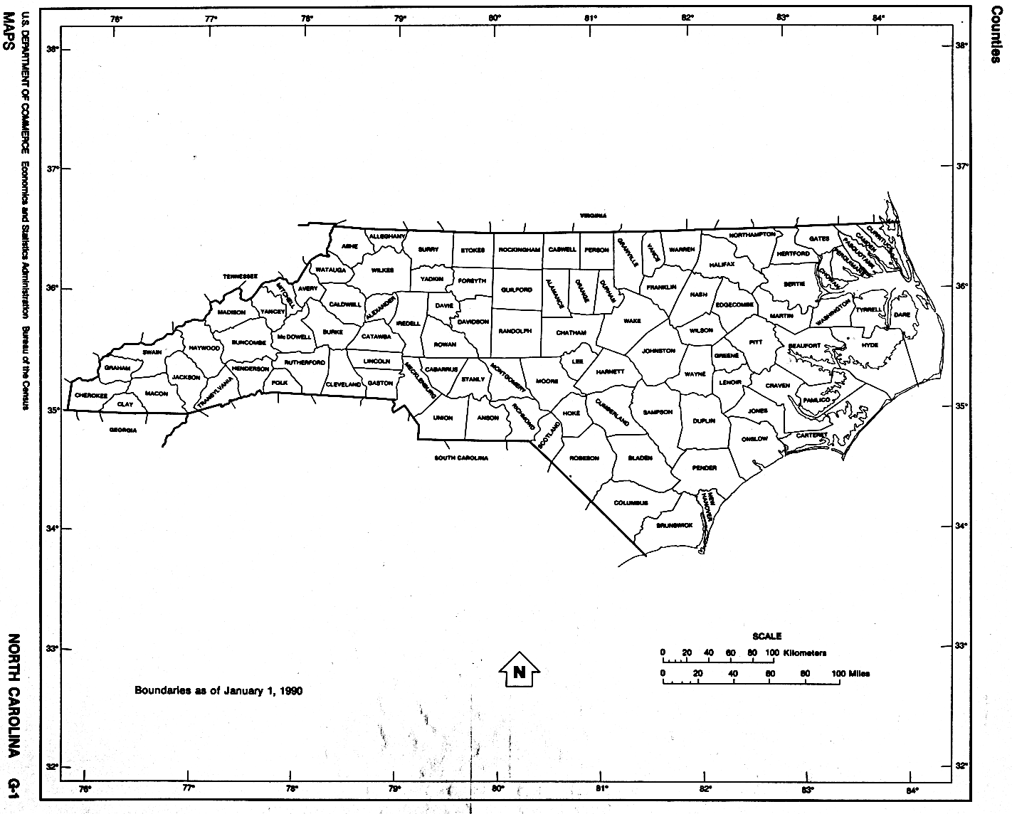
NC Counties
North Carolina has 100 counties…what do you notice? Think? Wonder?

Slide 10
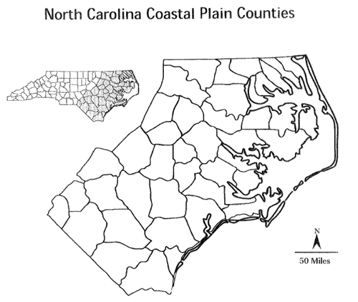
What do you notice about the counties in this region?

Slide 11
Coastal Plain
This landform is low, flat and gently sloping that extends along the Atlantic Ocean and the Gulf of Mexico. Most of the Southeast United States lies within the Coastal Plain.
Some maps show the Coastal Plain as two regions within one –
  the Outer Coastal Plain are a string of barrier islands separated from the mainland by sounds/inlets.
  The Tidewater is the area along the coast close to sea level.

Slide 12
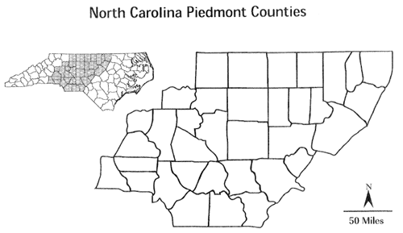
What do you notice about the counties in this region?

Slide 13
Piedmont
This landform is hilly, rolling land. It borders the Coastal Plain to its east and the Mountains to its west, in other words it is located in the middle of the state. The Piedmont region extends from Virginia to Alabama.
Piedmont literally means “foot of the mountain”.
Elevation ranges from 300 to 1,500 feet.

Slide 14
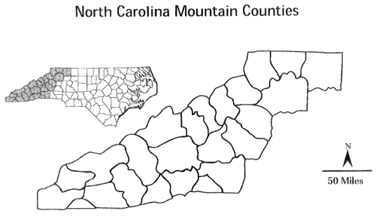
What do you notice about the counties in this region?

Slide 15
Mountain
This landform is the largest range of mountains in the eastern United States.
It is in the western part of the state, but it is smaller in area than the Piedmont and the Coastal Plain.
The elevation in this region reaches to more than one mile high.

